Slide 1
Online Teaching Philosophy
S. Pettus

Slide 2


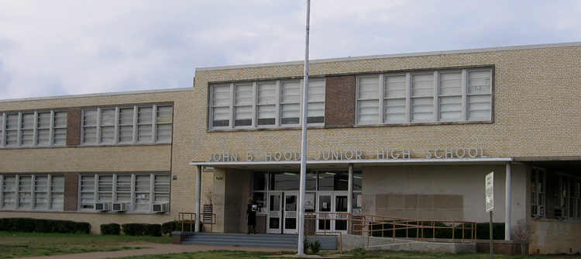


My beginnings in education

Slide 3


My passion is to train teachers to reach at-risk students.
Technology is --------→

Slide 4

Best Practice
Quality Matters
PBL
Andragogy

Slide 5


Goals
students to exceed current standard retention rates in online education and to enjoy the experience
Increase current student survey rating from 95% to 99%

